Slide 1
Software Engineering

Slide 2
Evaluation Scheme Theory:
MSE: 30 Marks, TA: 20 Marks, ESE: 50
Marks Laboratory: CIE: 50 Marks, ESE: 50 Marks

Slide 3
Software Engineering
Software Engineering is the systematic process of designing, developing, testing, and maintaining software to create reliable, efficient, and high-quality applications.
It applies engineering principles, methods, and tools to develop software in a systematic manner.
It supports teamwork, planning, documentation, testing, and maintenance to ensure successful software development throughout its lifecycle.
It helps create software that meets user requirements while ensuring reliability, security, efficiency, and maintainability.

Slide 4
Need of Software Engineering
Software engineering is a technique through which we can develop or create software for computer systems or any other electronic devices.
It is a systematic, scientific and disciplined approach to the development, functioning, and maintenance of software.

Slide 5
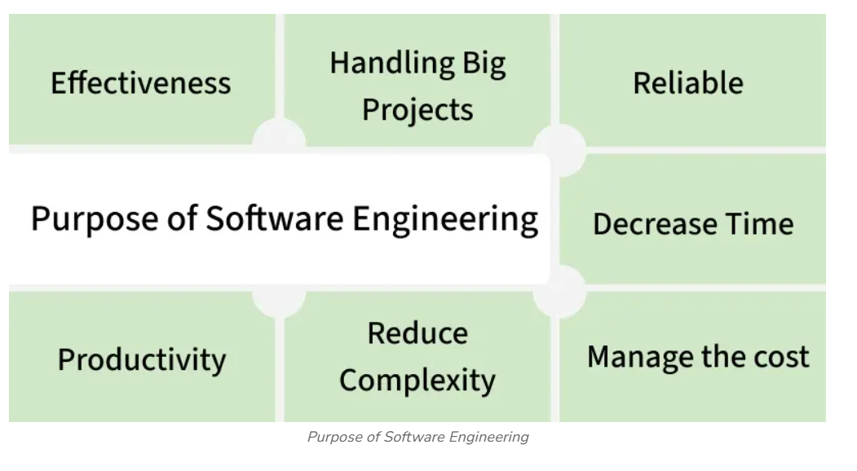

Slide 6
Handling Big Projects: A corporation must use a software engineering methodology in order to handle large projects without any issues.
To manage the cost: Software engineering programmers plan everything and reduce all those things that are not required.
To decrease time: It will save a lot of time if you are developing software using a software engineering technique.
Reliable software: It is the company's responsibility to deliver software products on schedule and to address any defects that may exist.

Slide 7
Effectiveness: Effectiveness results from things being created in accordance with the standards.
Reduces complexity: Large challenges are broken down into smaller ones and solved one at a time in software engineering. Individual solutions are found for each of these issues.
Productivity: Because it contains testing systems at every level, proper care is done to maintain software productivity.

Slide 8
Software Crisis and Myths,
What is Software Crisis?
Software Crisis is a term used in computer science for the difficulty of writing useful and efficient computer programs in the required time.
The software crisis was due to using the same workforce, same methods, and same tools even though rapidly increasing software demand, the complexity of software, and software challenges.

Slide 9
Suppose we use the same workforce, same methods, and same tools after the fast increase in software demand, software complexity, and software challenges.
In that case, there arise some issues like software budget problems, software efficiency problems, software quality problems, software management, and delivery problems, etc. This condition is called a Software Crisis.

Slide 10
Causes of Software Crisis
The cost of owning and maintaining software was as expensive as developing the software.
At that time Projects were running overtime.
At that time Software was very inefficient.
The quality of the software was low quality.
Software often did not meet user requirements.
At that time Software was never delivered

Slide 11
Factors Contributing to Software Crisis
Factor Contributing to Software Crisis are:
Poor project management.
Lack of adequate training in software engineering.
Less skilled project members.
Low productivity improvements.

Slide 12
Solution of Software Crisis:
There is no single solution to the crisis. One possible solution to a software crisis is Software Engineering because software engineering is a systematic, disciplined, and quantifiable approach. For preventing software crises, there are some guidelines:

Slide 13
Reduction in software over budget.
The quality of the software must be high.
Less time is needed for a software project.
Experienced and skilled people working on the software project.
Software must be delivered.
Software must meet user requirements.

Slide 14
Software Myths
Most, experienced experts have seen myths or superstitions (false beliefs or interpretations) or misleading attitudes (naked users) which creates major problems for management and technical people(leading to poor planning, communication issues, increased costs, delays, and lower software quality.

Slide 15
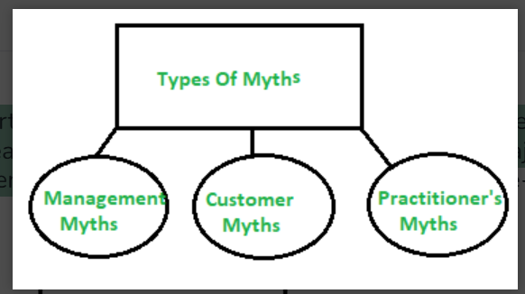

Slide 16
(i) Management Myths:
Myth 1:
We have all the standards and procedures available for software development.
Management may believe that having standards, guidelines, and procedures alone is enough to ensure a successful software project.

Slide 17
Fact:-
Standards and procedures provide only a framework for development
Success also depends on:
Skilled and experienced developers
Proper project planning
Good communication among team members
Effective project management
Regular testing and quality assurance
Continuous monitoring and risk management

Slide 18
Myth 2:
The addition of the latest hardware programs will improve the software development.
Fact:-
New hardware and tools can help, but they do not guarantee better software.
The success of software development depends mainly on:
Skilled and experienced developers
Well-defined requirements
Proper planning and project management
Effective communication
Good software engineering practices

Slide 19
Myth 3:
With the addition of more people and program planners to Software development can help meet project deadlines (If lagging behind)
Fact:-
New team members need time to understand the project.
Existing developers must spend time training and coordinating with them.
Communication and coordination become more complex as the team grows. As a result, the project may become even more delayed.

Slide 20
(ii)Customer Myths:
The customer can be the direct users of the software, the technical team, marketing / sales department, or other company.
Myth 1:
A general statement of intent is enough to start writing plans (software development) and details of objectives can be done over time.
Fact:-
Software development requires clear, complete, and detailed requirements before starting.

Slide 21
If requirements are incomplete or keep changing:
Developers may misunderstand customer needs.
More time and effort are required to make changes.
Development cost increases.
The project may be delayed.
Software quality may be affected.

Slide 22
Myth 2:
Software requirements continually change, but change can be easily accommodated because software is flexible.
Fact:-
Although software is flexible, every change affects the project.
Requirement changes may require:
Modifying the design
Changing the code
Updating documentation
Retesting the software

Slide 23
As development progresses, the cost and effort of making changes increase
Frequent changes can cause:
Project delays
Increased development cost
More defects (bugs)
Reduced software quality

Slide 24
iii)Practitioner’s Myths:
Myths 1:
They believe that their work has been completed with the writing of the plan.
Fact:-
software development does not end with coding. After coding, several important activities are still required:
Testing the software to find and fix bugs.

Slide 25
Preparing documentation.
Integrating the software with other modules.
Deploying the software.
Maintaining and updating the software after delivery.

Slide 26
Myths 2:
There is no other way to achieve system quality, until it is "running".
Fact:-
software quality can be ensured throughout the development process, not just after execution.
Quality can be improved by:
Requirement reviews

Slide 27
Design reviews
Code inspections
Unit testing
Integration testing
Static analysis
Verification and validation

Slide 28
Myth 3:
An operating system is the only product that can be successfully exported project.
Some developers believe that once the software runs correctly, the project is complete and nothing else needs to be delivered.

Slide 29
Fact:-
successful software project includes many deliverables besides the working software, such as:
Software documentation
Design documents
Test cases and test reports
User manuals
Installation and maintenance guides
Training materials (if required)

Slide 30
Myth 4:
Engineering software will enable us to build powerful and unnecessary document & always delay us.
Documentation is an important part of software engineering. Good documentation helps in:
Understanding the system
Team communication
Software maintenance
Future enhancements

Slide 31
Software engineering promotes necessary and useful documentation, not unnecessary paperwork.

Slide 32
Software Quality Attributes,
Software Quality Attributes are the characteristics that determine how well a software system performs and satisfies user requirements. They define the quality, reliability, efficiency, and usability of software.
Definition
Software Quality Attributes are measurable properties that describe the quality of a software system and determine whether it meets user expectations and business requirements.

Slide 33
Major Software Quality Attributes
1. Correctness
The software performs the required functions correctly.
It satisfies all specified user requirements.
2. Reliability
The software works consistently without failures.
It performs accurately under specified conditions for a given period.

Slide 34
3. Efficiency
The software uses system resources (CPU, memory, storage, network) effectively.
It provides fast response and good performance.
4. Integrity (Security)
Protects data from unauthorized access or modification.
Ensures confidentiality and data security

Slide 35
5. Usability
The software is easy to learn, understand, and use.
It provides a user-friendly interface
6. Maintainability
The software can be easily modified, corrected, or upgraded.
Makes fixing bugs and adding new features easier.

Slide 36
7. Flexibility
The software can be adapted to changing user requirements.
New features can be added with minimal effort.
8. Testability
The software can be easily tested to detect defects.
Supports effective verification and validation.

Slide 37
9. Portability
The software can run on different operating systems or hardware platforms with little modification.
10. Reusability
Software components can be reused in other applications.
Reduces development time and cost.

Slide 38
11. Interoperability
The software can communicate and exchange data with other systems.

Slide 39
Software Process and development
What is Software Development Process?
The software development process is the approach to developing, and delivering software applications. This process might include improving design and product management by splitting the work into smaller steps or processes.

Slide 40
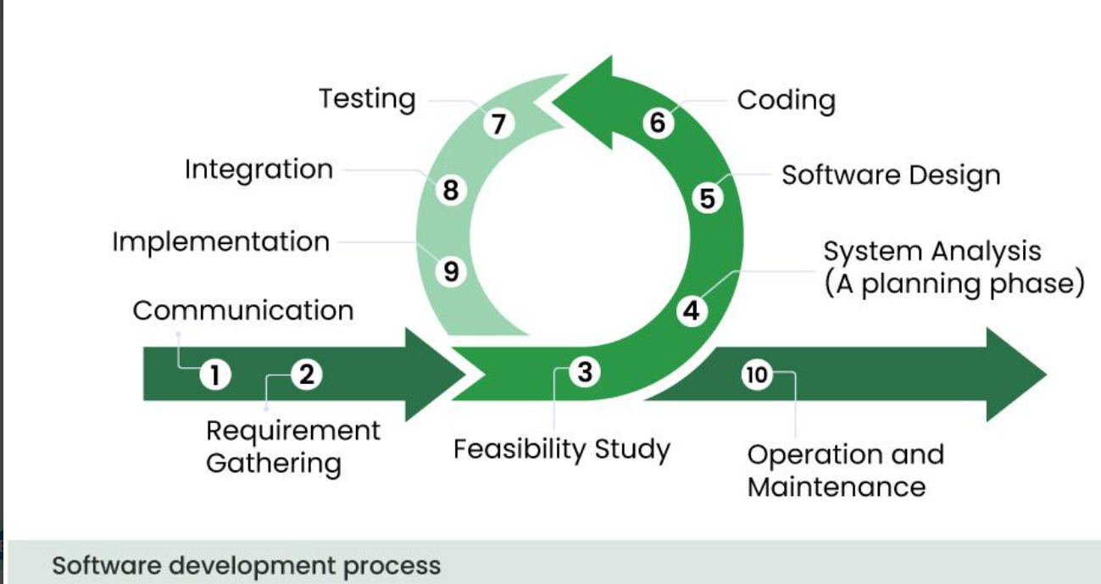

Slide 41
1. Communication
Developers meet with the client or stakeholders.
They discuss the problem and understand what the software should do.
Goal: Understand the client's needs.
2. Requirement Gathering
Collect all functional and non-functional requirements.
Document them clearly.
Output: Software Requirements Specification (SRS).

Slide 42
3. Feasibility Study
Analyse whether the project is possible.
Check:
Technical feasibility: Can it be built?
Economic feasibility: Is it within budget?
Operational feasibility: Will users accept it?
Time feasibility: Can it be completed on time?
Goal: Decide whether to proceed.

Slide 43
4. System Analysis (Planning Phase)
Study the requirements in detail.
Break the project into modules.
Plan resources, schedule, risks, and architecture.
Goal: Create a clear development plan.

Slide 44
5. Software Design
Design how the software will work.
Create:
Database design
User interface (UI)
System architecture
Algorithms
Output: Design documents.

Slide 45
6. Coding
Developers write the actual program using programming languages such as Java, Python, C++, or JavaScript.
Goal: Convert the design into working software.
7. Testing
Testing is the process of checking whether the software works correctly and meets the user's requirements.
It helps identify and fix errors (bugs) before the software is delivered to users.

Slide 46
Common testing types:
Unit Testing
Integration Testing
System Testing
8. Integration Integration is the process of combining all the individual software modules (frontend, backend, database, APIs, and libraries) into one complete system so they work together correctly.

Slide 47
9. Implementation (Deployment)
Implementation is the stage where the completed software is installed and made available for users to use in the real environment.
10. Operation and Maintenance
Operation and Maintenance is the final phase of the Software Development Process (SDP). In this phase, the software is used by end users, monitored for performance, and regularly updated to fix bugs, improve features, and adapt to changing technologies or user requirements.

Slide 48
Activities in Operation and Maintenance
Monitor software performance.
Fix bugs and errors.
Provide user support and documentation.
Update the software with new features.
Improve performance and security.
Ensure compatibility with new technologies and operating systems.

Slide 49
Software life cycle and Models
The Software Development Life Cycle (SDLC) is a structured process used to plan, design, develop, test, deploy, and maintain software. It provides a systematic approach to building software that meets business goals and user requirements.
Definition
Software Development Life Cycle (SDLC) is a step-by-step process followed by software developers to create high-quality software efficiently and systematically

Slide 50
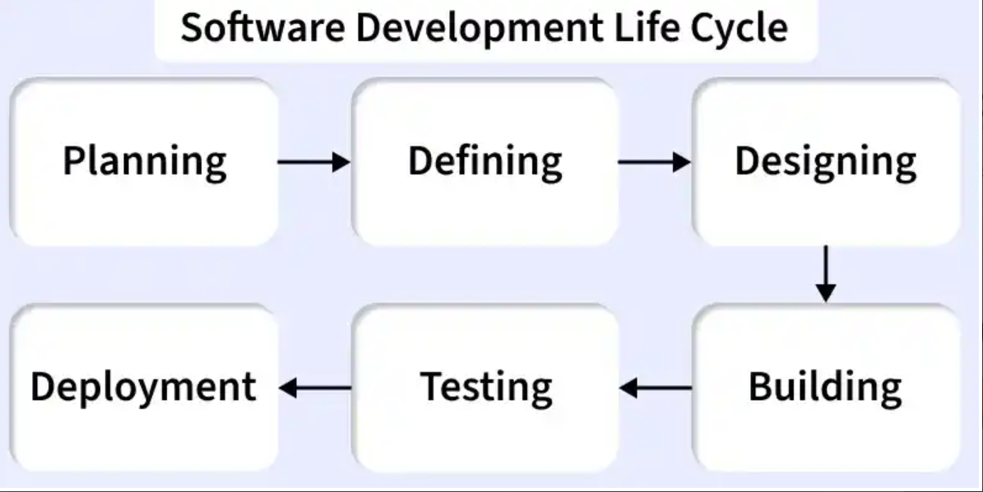

Slide 51
Stage 1: Planning & Feasibility Analysis
This is the first stage of the Software Development Life Cycle (SDLC). In this stage, the organization decides whether the proposed software project is practical and worth developing.
Definition
Planning and Feasibility Analysis is the process of identifying project goals, estimating resources, cost, time, and analyzing whether the project is technically, financially, and operationally feasible.

Slide 52
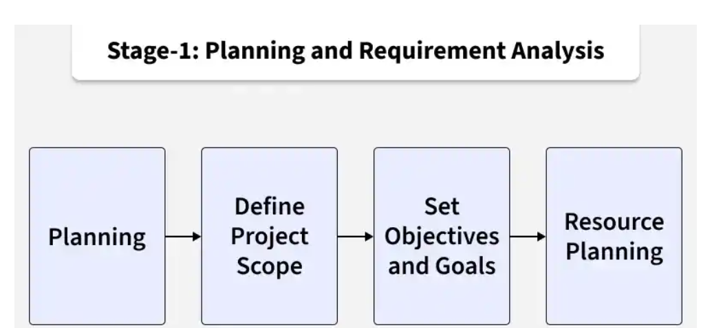

Slide 53
Stage 2: Requirement Specification (SRS)
This is the second stage of the Software Development Life Cycle (SDLC). In this stage, all the software requirements are collected, analyzed, documented, and approved by the stakeholders.
Definition
Requirement Specification (SRS) is the process of identifying, documenting, and validating all functional and non-functional requirements of the software before development begins.

Slide 54
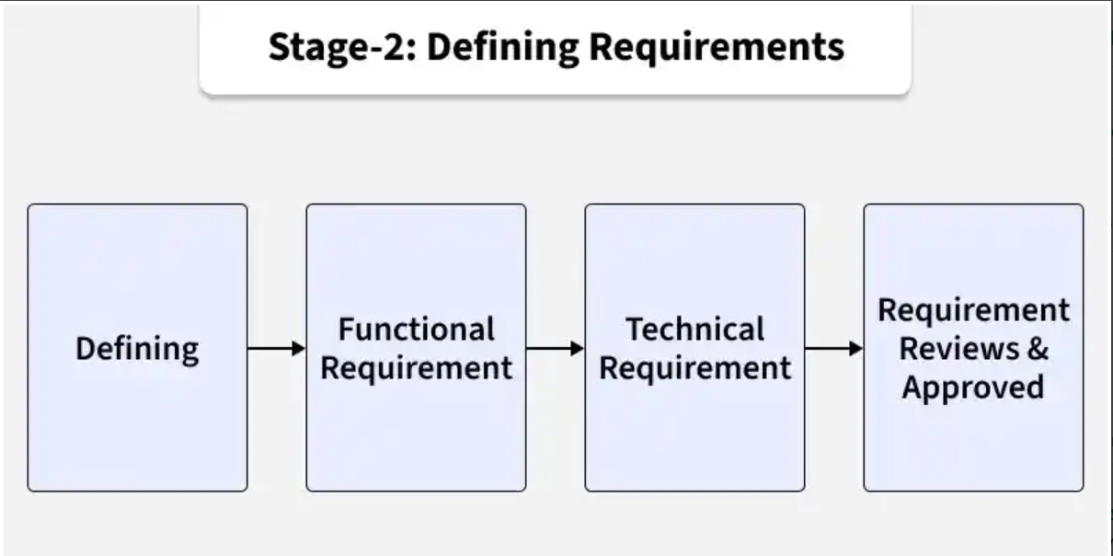

Slide 55
Stage 3: System Design
The System Design phase is the third stage of the Software Development Life Cycle (SDLC). In this stage, the approved requirements from the SRS document are converted into a technical blueprint for software development.
Definition:-
System Design is the process of creating the architecture and detailed design of the software based on the approved requirements. It defines how the system will be built.

Slide 56
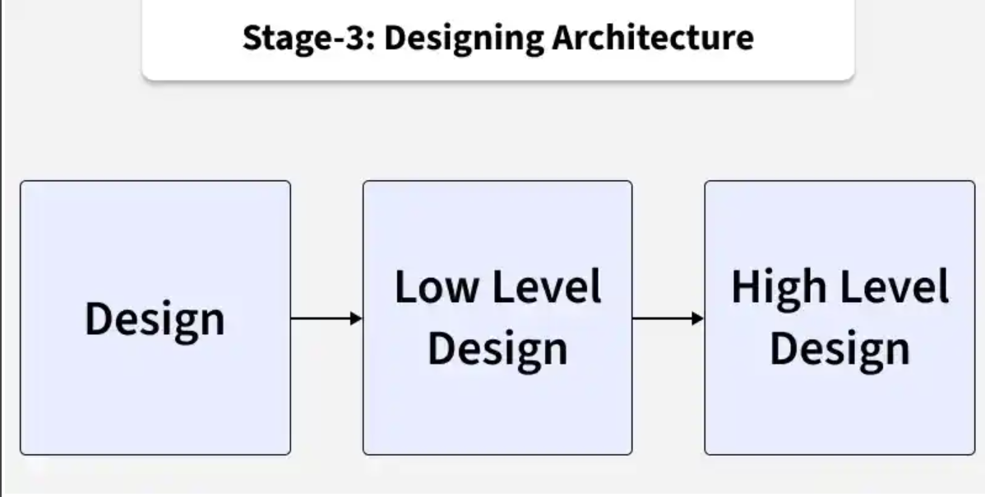

Slide 57
1. High-Level Design (HLD)
High-Level Design describes the overall structure of the system.
It includes:
System architecture
Technology stack (programming languages, frameworks, tools)
Database design
Major modules and their interactions

Slide 58
2. Low-Level Design (LLD)
Low-Level Design provides detailed information about each module.
It includes:
Component logic
APIs (Application Programming Interfaces)
Data structures
Algorithms
Workflows and process flow
Class and sequence diagrams

Slide 59
Stage 4: Development (Coding)
The Development (Coding) phase is the fourth stage of the Software Development Life Cycle (SDLC). In this stage, developers write the actual program code based on the Design Document Specification (DDS) created during the design phase.
Definition
Development (Coding) is the process of converting the software design into executable source code using programming languages and development tools.

Slide 60
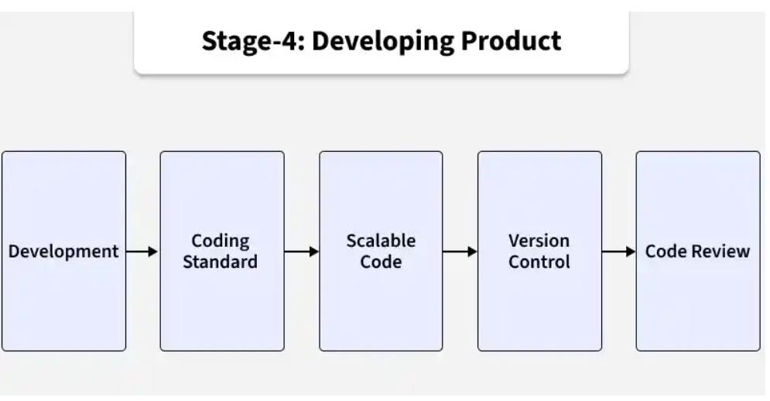

Slide 61
Stage 5: Testing
The Testing phase is the fifth stage of the Software Development Life Cycle (SDLC). In this stage, the software is tested to ensure it meets the specified requirements and is free from defects (bugs) before being released to users.
Definition
Testing is the process of verifying and validating the software to ensure it works correctly, meets user requirements, and performs as expected

Slide 62
Types of Testing include:
Unit Testing: Verifies individual components
Integration Testing: Ensures modules work together
System Testing: Validates the complete system
User Acceptance Testing (UAT): Confirms business requirements are met.

Slide 63
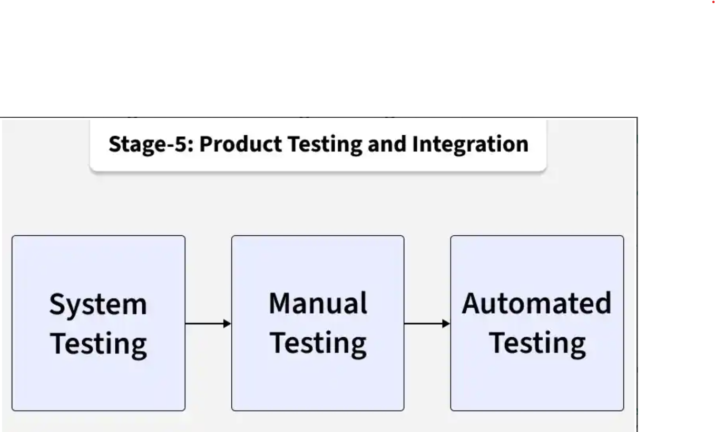

Slide 64
Stage 6: Deployment
The Deployment phase is the sixth stage of the Software Development Life Cycle (SDLC). In this stage, the tested software is released to the production environment so that end users can use it.
Definition
Deployment is the process of installing, configuring, and releasing the software into the production environment for users.

Slide 65
Stage 7: Maintenance
The Maintenance phase is the final stage of the Software Development Life Cycle (SDLC). After the software is deployed, it is continuously monitored, updated, and improved to ensure it remains reliable, secure, and useful for users.

Slide 66
Importance of SDLC
Provides a clear and organized development framework.
Improves planning, cost control, and project management.
Ensures better quality through defined testing phases.
Helps deliver software that meets user and business needs

Slide 67
Example: Online Library Management System
1. Planning & Feasibility Analysis
The college decides to develop an Online Library Management System.
The team checks whether the project is technically, financially, and operationally feasible.
Output: Project plan and feasibility report.

Slide 68
2. Requirement Specification (SRS)
Requirements are collected from the librarian, students, and college management.
Functional Requirements:
User login
Search books
Issue and return books
Fine calculation
Non-Functional Requirements:
Fast response time
Secure login
Easy-to-use interface

Slide 69
3. System Design
The system architecture, database, and modules are designed.
HLD: User Management, Book Management, Issue/Return, Reports.
LLD: Login logic, database tables, APIs, workflows.
4. Development (Coding)
Developers write the source code.
Frontend developers create the user interface.
Backend developers develop the database and APIs.

Slide 70
5. Testing
The software is tested for defects.
Unit Testing: Test the login module.
Integration Testing: Check communication between modules.
System Testing: Test the complete library system.
UAT: Librarians and students verify the software.

Slide 71
6. Deployment
The application is installed on the college server.
Smoke testing ensures the main features work correctly.
7. Maintenance
Bugs are fixed after deployment.
New features such as online book reservation are added.
Security updates and performance improvements are provided.

Slide 72
Common Models
Waterfall Model
Agile Model
V-Model
Spiral Model
Incremental Model
RAD Model

